Slide 1
BRAIN TUMOR IMAGE SEGMENTATION
Ammar Mustufa
Haoyi Zhou
Isha Verma
Shashank Rao
Karthik Thiagarajan

Slide 2
TABLE OF CONTENTS
01
02
INTRODUCTION
DATASET
03
04
05
MODELS
ANALYSIS
CONCLUSION

Slide 3
01
INTRODUCTION

Slide 4
Purpose of Our Models
Brain tumors are a critical health issue requiring accurate and timely diagnosis
MRI is a widely used tool for detecting and analyzing brain tumors
Developing models for tumor classification and segmentation can:
Assist radiologists in making faster and more reliable diagnoses.
Improve treatment planning and patient outcomes.
Reduce the workload for healthcare professionals.
Our goal is to build models that can classify and segment brain tumor images effectively.

Slide 5
02
DATASET BRAIN MRI IMAGES

Slide 6
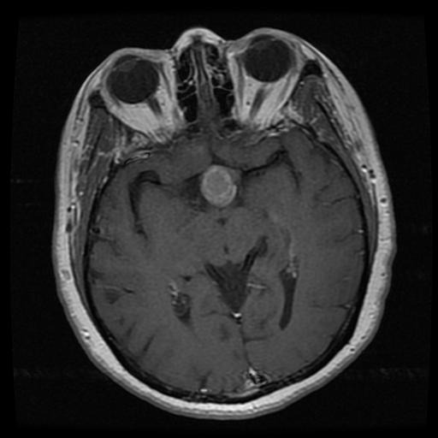
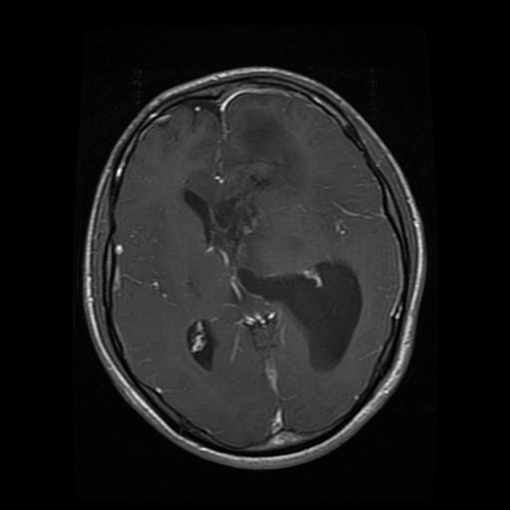
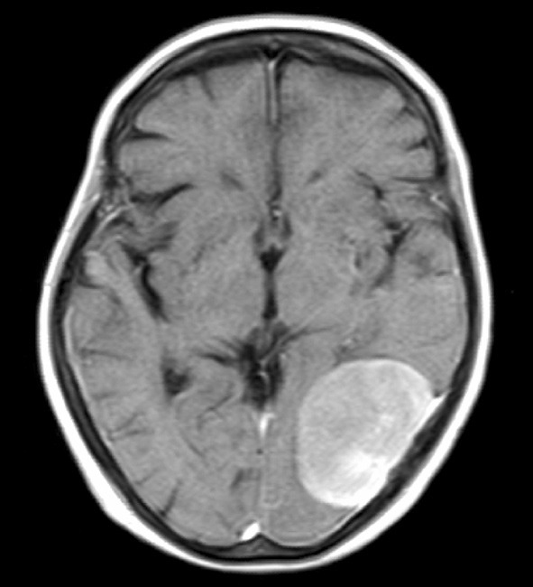
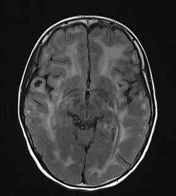
Classification Dataset
7023 images
4 classes
Pituitary
Glioma
Meningioma
No Tumor

Slide 7
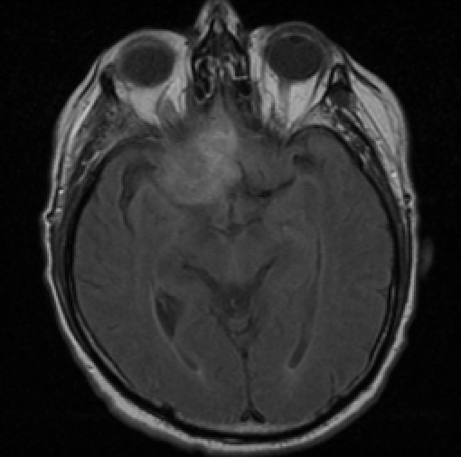
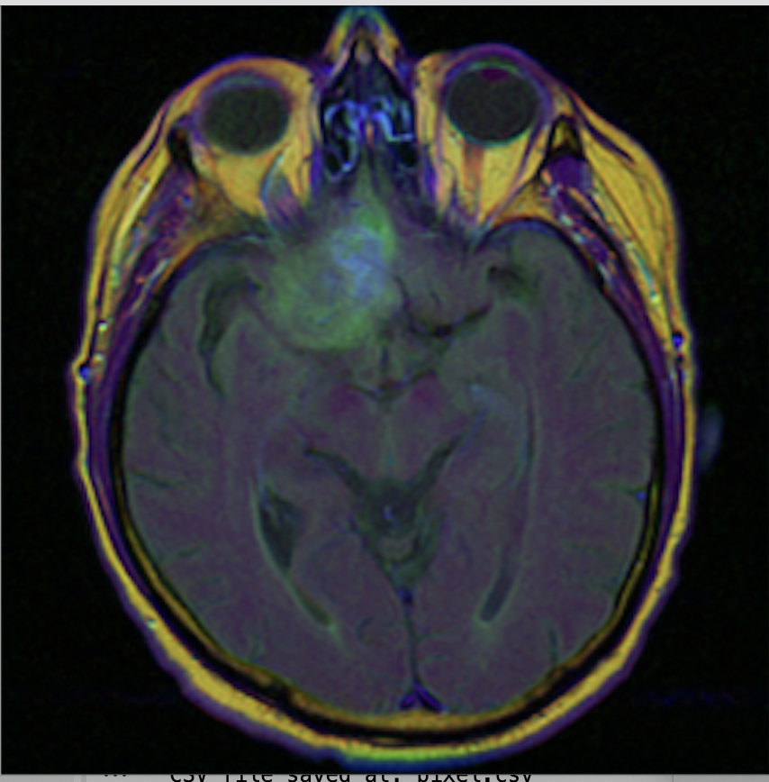
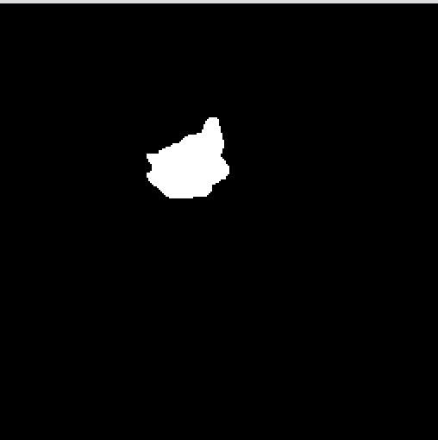
Segmentation Dataset
110 patients
~7850 images
Each scan has mask associated for training the model
Mask
MRI Scan
Transformed

Slide 8
03
MODELS

Slide 9
Classification Models
SVM
Vision Transformer

Slide 10
SEGMENTATION MODELS
UNET
UNET R
Mixture of Experts (MOE)

Slide 11
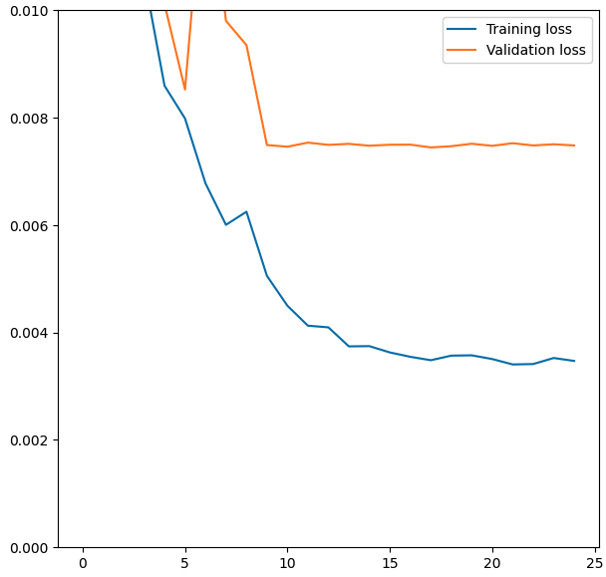
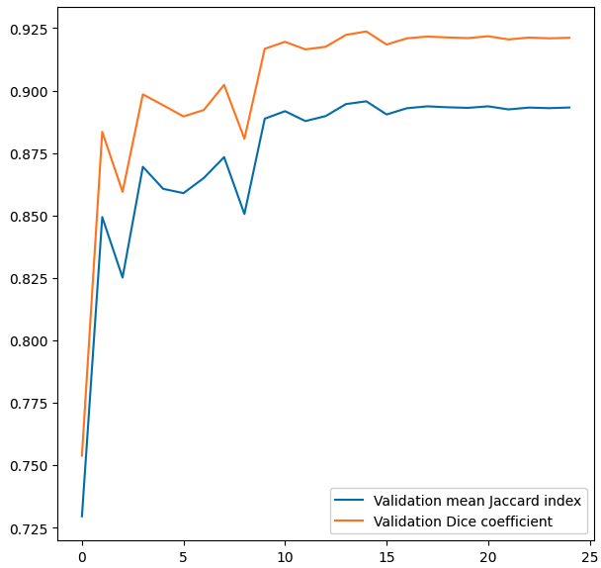
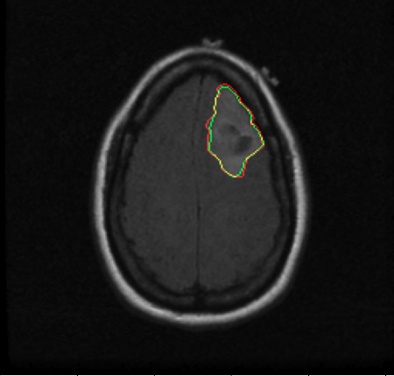
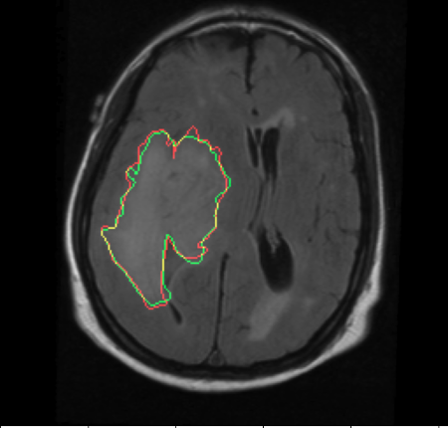
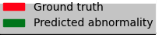
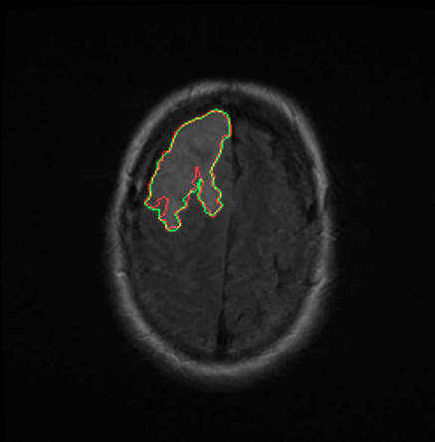
UNET
Pre - Trained Model (from hugging face)
google/vit-base-patch16-224
Mean IOU: 86.5%
Dice Coefficient: 89.7%

Slide 12
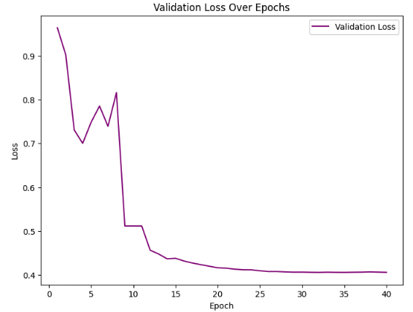
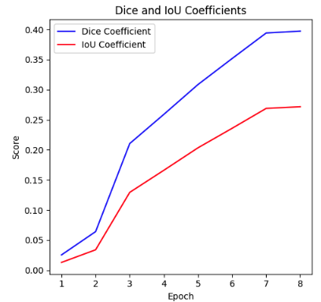
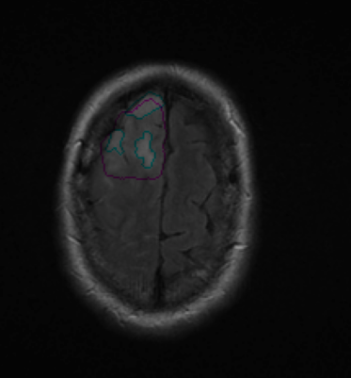
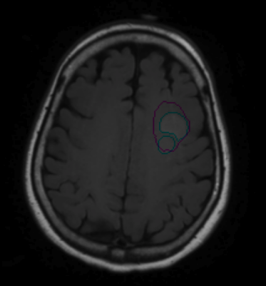
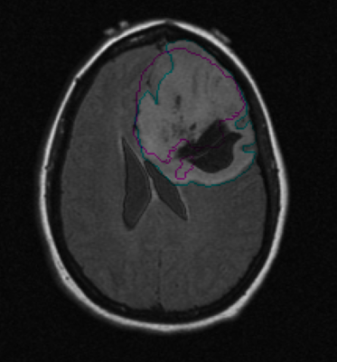
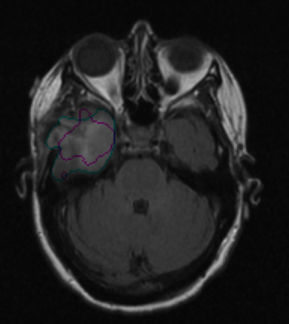
UNET R

Slide 13
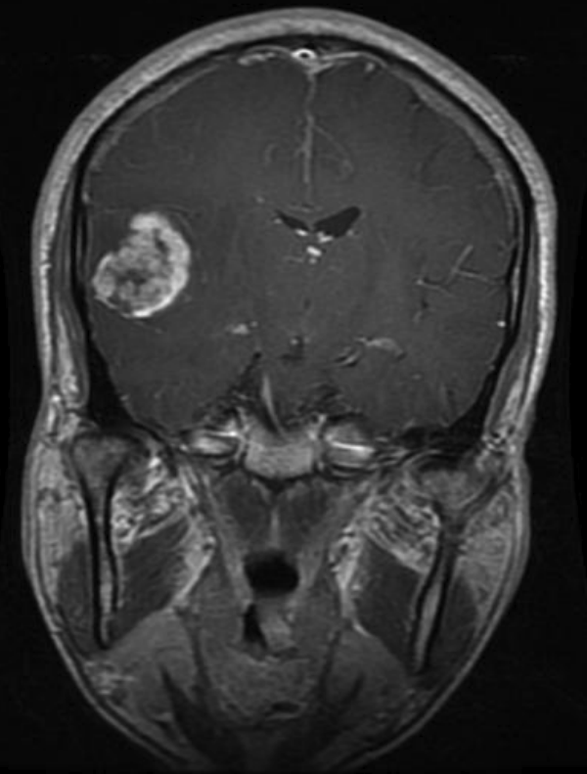
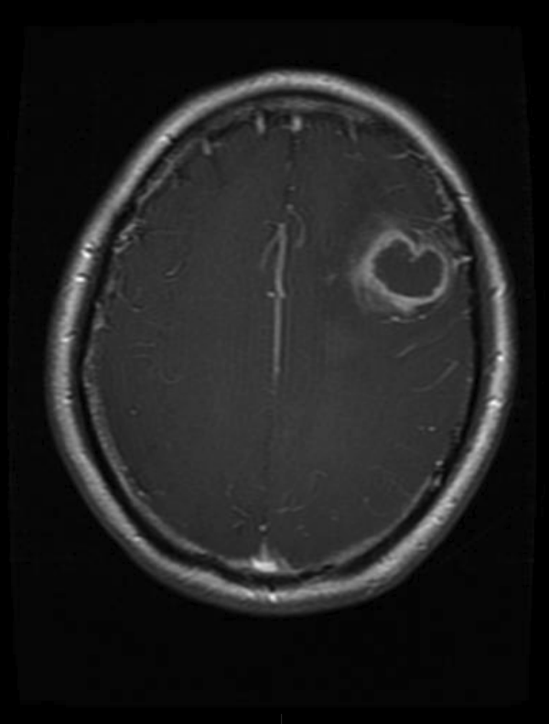
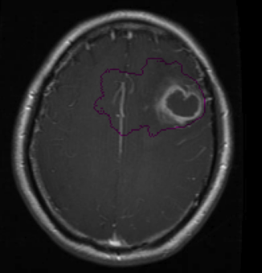
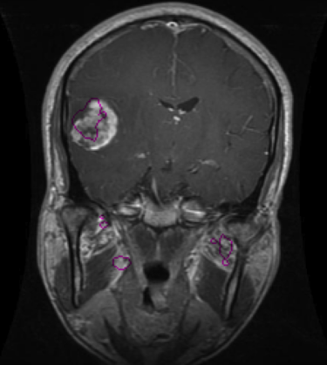
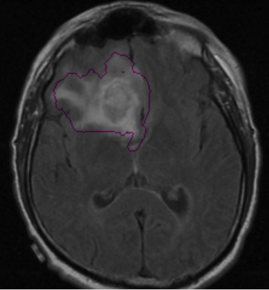
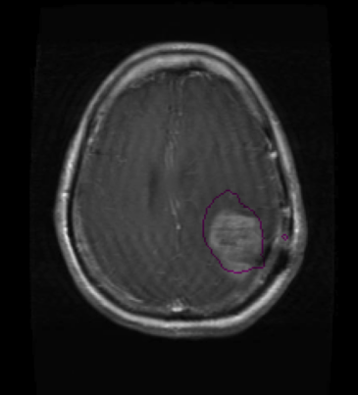
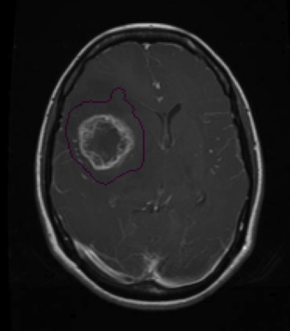
UNET R
Classification Sample - Results

Slide 14
Cascade MOE System
A Cascade Mixture of Experts (MoE) system is a hierarchical neural network architecture that processes inputs through a series of expert models. Each expert model specializes in a specific task or domain. The system determines the optimal sequence of experts to activate based on the input's complexity and the confidence of previous expert decisions.
Efficient Design: Only triggers segmentation MoE when the classification MoE identifies a tumor, saving computational resources and increasing accuracy.
Task-Specific Processing: Ensures each step focuses on relevant tasks (classification first, then segmentation if needed).
How It Works:
Shared Feature Extraction:
A modified ResNet processes grayscale MRI images to extract deep features.
Classification MoE:
Consists of 3 experts: ResNet, EfficientNet, and Vision Transformer (ViT).
Identifies if a tumor is present using combined image and clinical data.
Gating network assigns importance weights to each expert based on the input.
Segmentation MoE (Triggered only for tumor-positive cases):
Includes 2 experts: U-Net and DeepLabv3+.
Pinpoints the tumor location in the MRI.
Another gating network selects the most relevant segmentation expert for the task.

Slide 15
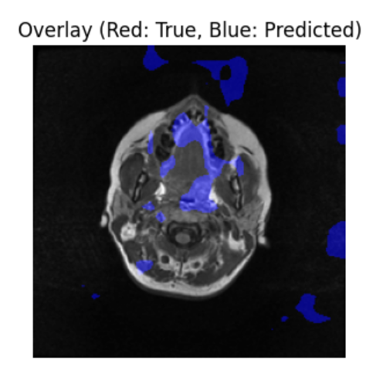
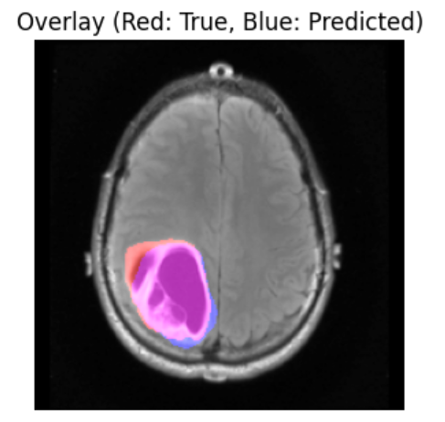
Before VS After Cascade

Slide 16
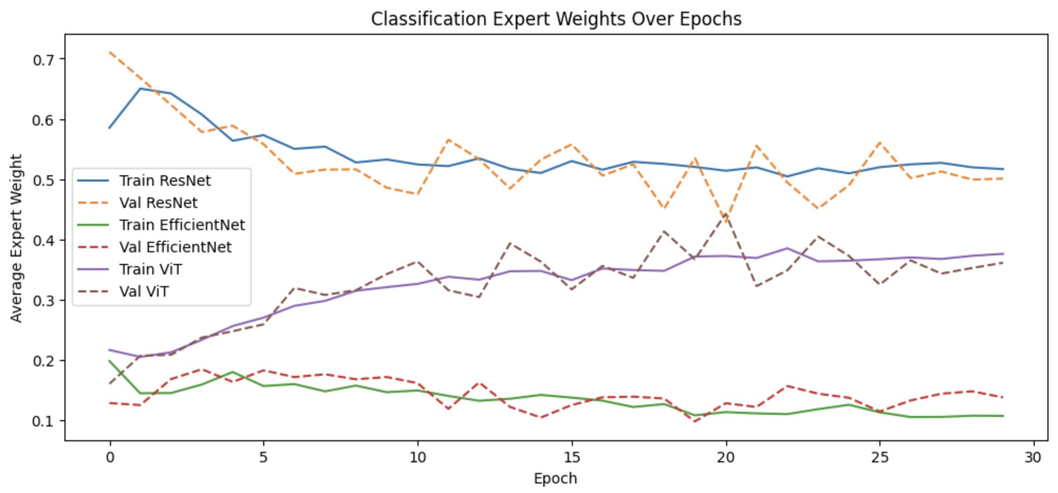
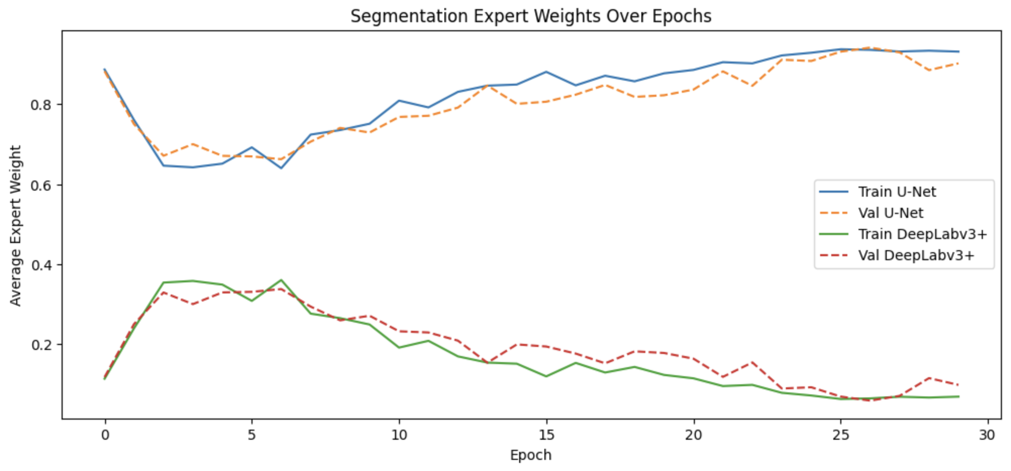
Mixture of Experts
Classification
ResNet
EfficientNet
Vision Transformer (ViT)
Segmentation
UNet
DeepLabv3+

Slide 17
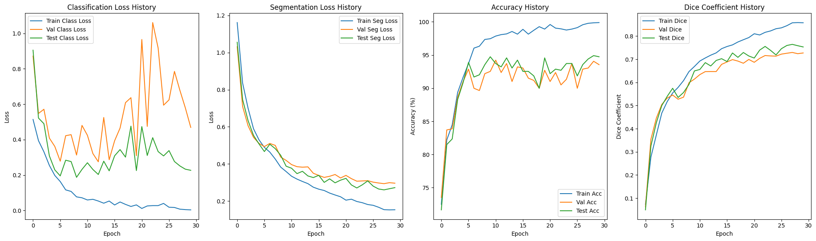
Mixture of Experts

Slide 18
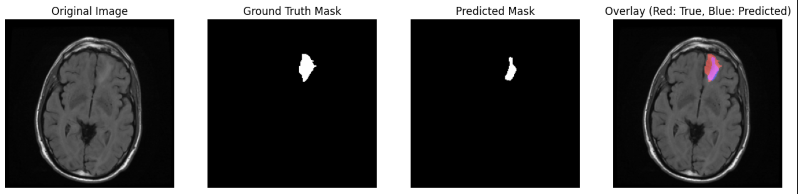
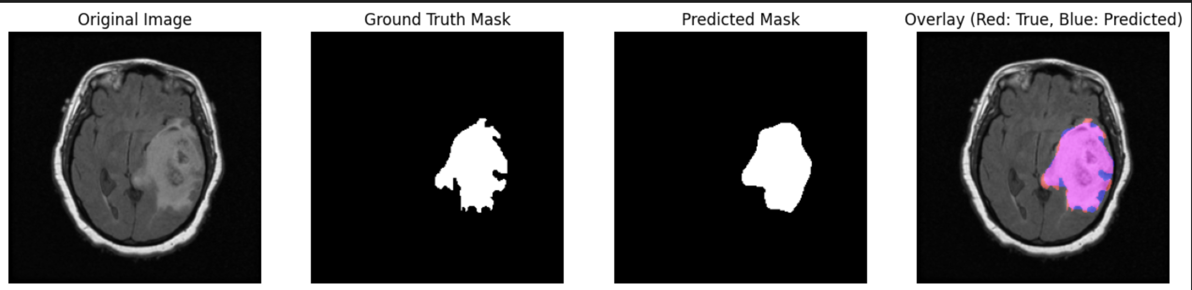
MOE - Results

Slide 19
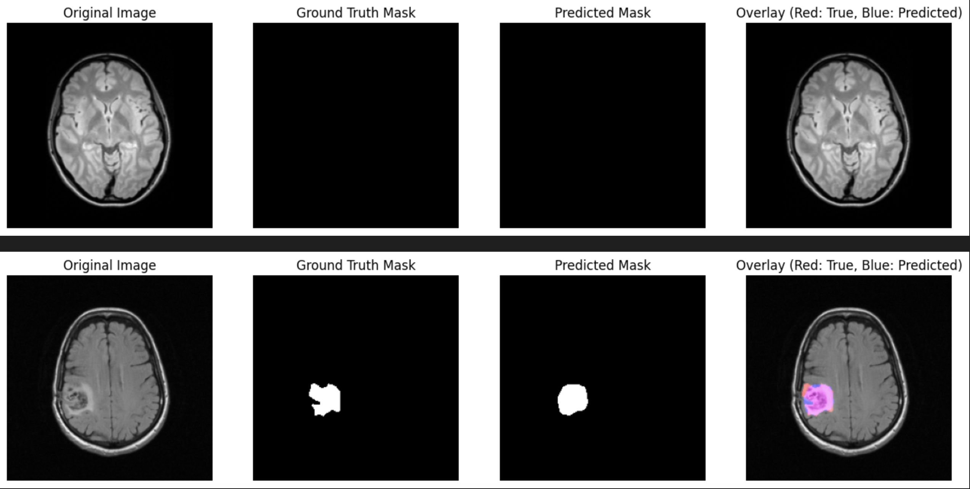
…Results

Slide 20
04
ANALYSIS

Slide 21
05
CONCLUSION

